Slide 1

Short Courses Student Induction

Slide 2


Contents
Classroom etiquette
Health and safety
Fire exits
Smoking
Toilets
Social media
Customer service
More courses available
Feedback – prize!

Slide 3

Classroom etiquette
Please leave the rooms as you find them and throw away any rubbish you create
Please do not eat in the classroom
Water in a sealed bottle is permitted, this can be filled up at the nearest water point, and your tutor can point out where this is
There is no access to the classrooms or workshops after class, but you are welcome to use the library or communal areas

Slide 4

Health and safety
Please follow instructions given to you by your tutor
Always ask your tutor if you are unsure of what to do or if you are concerned something might be dangerous

Slide 5

Fire exits
If there is a Fire, Please leave the building via the nearest exit - don’t stop for your things, and follow instructions given by fire wardens

Slide 6

Smoking
Smoking, including vaping, is not permitted on site

Slide 7

Toilets
Your tutor can tell you where your nearest toilets are

Slide 8
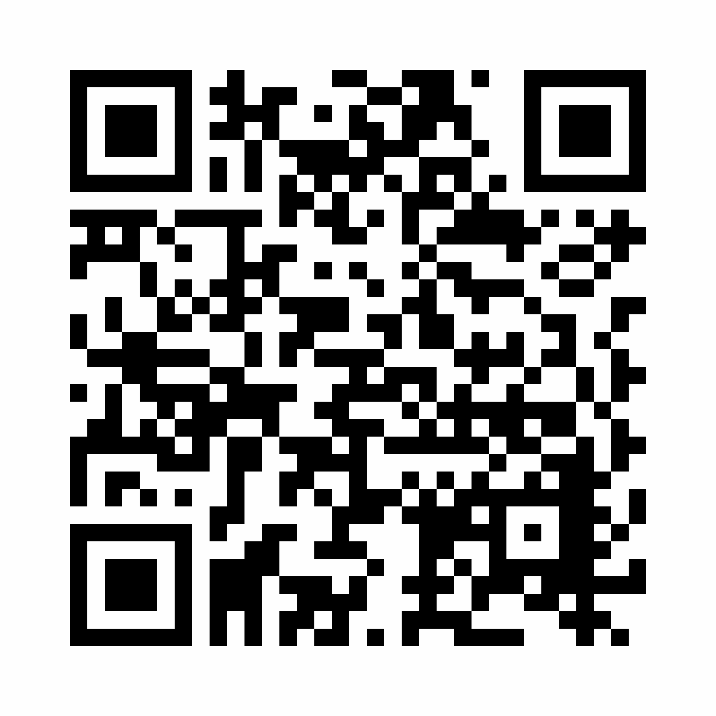

Social media
We love to repost student creations. Feel free to share your work on social media, use hashtags and tag @ualshortcourses on Instagram
Please do not photograph or film other students or staff, or their work, without consent

Slide 9

Customer service
Please ask your tutor if you have any questions about the course
Contact Customer services by email (or at reception at CSM) if you have any queries not about the course
ualshortcourses@arts.ac.uk

Slide 10

More courses available!
Check out the other short courses we offer:
https://www.arts.ac.uk/study-at-ual/short-courses

Slide 11
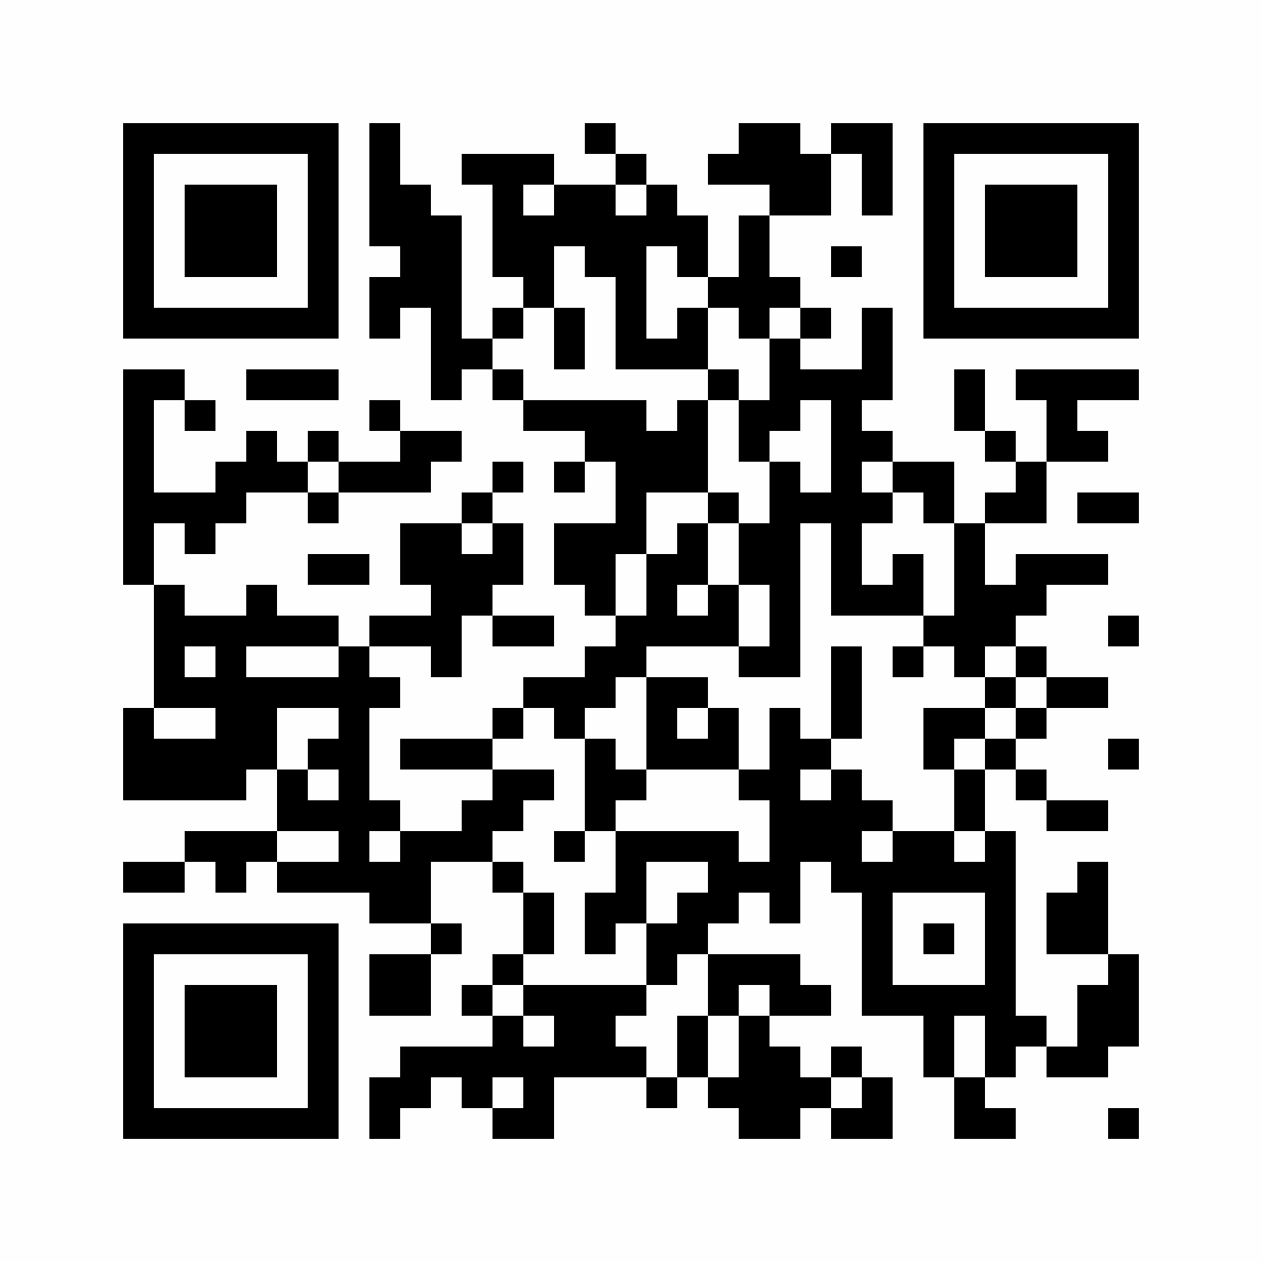
Stay in touch
Scan the QR code to sign up to our mailing list and hear more about our courses and industry updates!

Slide 12

Feedback
By submitting your feedback, you are in for a chance to win a free Graded Awards Short Course or 'Not Just a Shop' vouchers

